Slide 1
Python Programming
Scott Wallace

Slide 2
Outline
Python Basics
Comparison to other languages
Builtin DataTypes
Everyday tasks
More on Python
Objects, etc
ML / Tools
Where to get python:
https://www.anaconda.com/download/

Slide 3
Python
High-Level Interpreted (Scripting) Language
Python’s Type System
Strong (like C, not Lisp)
Types aren’t implicitly converted
Dynamic (like Lisp not C)
Types are discovered at runtime, not declared beforehand

Slide 4
Things You Really Care About
Whitespace counts
Use spaces, not tabs!
Everything is an object
Python has an interpreter – use it
Use a real editor that has a python mode
VSCode
Jupyter Notebook
Google Colab
Emacs
Vim
PyCharm

Slide 5
Basic Numeric Datatypes
Integers 10000
Integers grow arbitrarily large
Similar to BigInt in Java
Note that division yields a float! 1/10 = 0.1
Floating Point 4.5123

Slide 6
Additional Critical Data Types
Strings “Hello World”
Byte-arrays b’hi there’
Tuples (1, 4, 5)
Lists [1, 4, 5]
Dictionaries {“first” : 1, “second” : 2}
Sets {‘a’, ‘b’, ‘c’}

Slide 7
Things to Note
There is no character data-type
Strings are not byte-arrays
Strings and tuples are immutable
you cannot modify them without creating a new instance
Lists, dictionaries, and sets are mutable
They work like you’d probably expect

Slide 8
Strings
Strings can be formed in a few ways such as:
Double quotes: “Hello World”
Single quotes: ‘Hello World’
Triple quotes: “““Hello World”””
f-strings: f”Hey {Bob}”
raw strings: r”Hey cheese\n”
format method:
“Hi Professor {name}”.format(name=‘W’)
“Hi Professor {0}”.format(‘W’)

Slide 9
Types and Arithmetic
‘hi’ + ‘there’ == ?
[1]*5 == ?
‘Hi’*5 == ?
{‘a’, ’b’} + {‘c’} == ?
Notes:
Set addition is undefined!

Slide 10
Indexing
Can index into strings, tuples, lists and dictionaries (use ‘[‘ ‘]’ regardless)
>>> cheese = (“brie”, “colby”)
>>> cheese[0]
‘brie’
>>> cheese[0][2]
‘i’

Slide 11
Setting elements
Can set elements using index notation
Objects must be mutable
>>> cheese = (‘brie’, ‘colby’)
>>> cheese[0] = ‘cheddar’
ERROR
Can’t set tuple or string elements – they’re immutable

Slide 12
Setting elements
>>> cheese = [‘brie’, ‘colby’]
>>> cheese[0] = ‘cheddar’
>>> cheese
[ ‘cheddar’, ‘colby’]
>>> cheeses = { ‘french’: ‘brie’,
‘american’:’kraft’ }
>>> cheeses[‘french’] = ‘camembert’

Slide 13
Indexing
Arrays are 0 indexed, like Java and C
>>> c = [‘swiss’, ‘brie’, ‘colby’]
>>> c[0]
‘swiss’
>>> c[3]
IndexError: list index out of range
[ ‘swiss’ , ‘brie’ , ‘colby’ ]
0 1 2 3

Slide 14
Indexing
Python also understands negative indices!
>>> c = [‘swiss’, ‘brie’, ‘colby’]
>>> c[0] == c[-3]
True
[ ‘swiss’ , ‘brie’ , ‘colby’ ]
0 1 2 3
-3 -2 -1

Slide 15
Slicing
Slices refer to a portion of a list
>>> c = [‘swiss’, ‘brie’, ‘colby’]
>>> c[0:2] # note that c[2] is not in this slice!
[‘swiss’,’brie’]
>>> c[0:2] = [‘crackers’]
>>> c
[‘crackers’,’colby’]

Slide 16
Functions
Note: whitespace is important
Indentation identifies blocks
Lines just end (no ‘;’ )
Variables are local
def plus1(x):
return x + 1

Slide 17
Looping
for loop is just like foreach
for <item> in <list>:
<body>
The range() function builds an increasing list
Generally, avoid using range, you probably don’t need it

Slide 18
Other Flow Control
while statement works like C or Java
if … then tests don’t require parenthesis:
if x == 2:
# do something
elif x == 3:
# do something else
else:
# do the last thing

Slide 19
Pass to create empty blocks
def do_nothing(x):
pass
if x == 2:
pass
else:
print(“X is not 2”)

Slide 20
It Really is This Easy!
CLRS Merge Sort Pseudo Code
SW Python Executable Code
MergeSort (A, p, r)
if p < r
then q ← floor( (p+r)/2 )
MergeSort(A, p, q)
MergeSort(A, q+1, r)
Merge(A, p, q, r)
def merge_sort(A, p, r):
if p < r:
q = (p+r)/2
merge_sort(A,p,q)
merge_sort(A,q+1,r)
merge(A,p,q,r)

Slide 21
Scripts
#!/usr/bin/env python3
def times2( x ):
return x*2
if __name__== “__main__”:
print( times2( 10 ) )
Assuming the code at left is stored in a file ‘script’, it can be run on the command line like:
> chmod 755 script
> ./script

Slide 22
Modules: Storing Code in Files
We can package code in a file
To make a script
To make a module
Files that end with ‘.py’ are modules
Modules can be used in the interpreter, or by other modules

Slide 23
Modules
To use a module, import it
#!/usr/bin/env python3
def plus10(x):
return x+10
if __name__ == “__main__”:
import sys
print(plus10(int(sys.argv[1])))

Slide 24
Modules you might care about
os - file system operations
sys - command line arguments
time - system time, etc
random - random number generator
re - regular expressions
heapq - turns lists into heaps!
argparse - CLI argument parsing

Slide 25
Examples and Memes

Slide 26
List Directory Contents / Open a file
>>> import os
>>> os.listdir(‘.’)
['Liens-50', 'ps0.pdf', 'ps0.tex’]
>>> with open(‘ps0.tex’) as fin:
>>> data = fin.read()
>>>

Slide 27
More Craziness

Slide 28
Dealing with Lists/Dictionaries
Calling .sort() on a list will sort items in natural order
A set of tuples’ natural order will sort first by item 0, and break ties with remaining items
Using a dictionary in the context of a sequence will result in iteration over the dictionaries keys
>>>for k in {‘a’:1, ‘b’:10, ‘c’:12}:
print k
a
c
b

Slide 29
Objects

Slide 30
Objects & Classes
In Python, everything is an object – although that’s not always obvious.
The simplest class:
class SimpleClass:
pass

Slide 31
Methods and self
Define a Class
Create an Instance, Call a Method
class SimpleClass:
def __init__(self):
self.x = 4
def morex(self):
self.x += 4
z = SimpleClass()
z.morex()

Slide 32
Etc

Slide 33
Default Parameters
def addto( a, b=9):
return a + b
Invocation:
>>> addto( 1 )
>>> addto( 2, 10 )
What’s going to happen here?

Slide 34
Default Parameters & A Mystery
def addto( a, l = [ ] ):
l.append( a )
return l
>>> addto( 1 )
[ 1 ]
>>> addto( 7, [1,2,3] )
????
>>> addto( 2 )
????

Slide 35
List Comprehensions
Applying an operation to a list:
>>> a = range(5)
>>> b = [x*2 for x in a]
Refining a list:
>>> a = range(5)
>>> b = [x for x in a if x % 2 == 0]

Slide 36
More comprehensions
Sets:
s = {char for char in ‘hello there cheddar’}
Dictionaries:
s = {char:char*2 for char in ‘hello’}

Slide 37
More Craziness
def outer( operand ):
def inner( x ):
return x + operand
return inner
What have I done here?
Why would anyone ever care?

Slide 38
Docstrings and help()
Docstrings provide built in documentation for modules, functions, classes and methods.
def add4(x):
“““Add 4 to the value specified”””
return x+4
Docstrings can be accesses in the interpreter using
>>> help(<object or name>)

Slide 39
Recap
Basic types: number, lists, dictionaries, tuples, sets
Whitespace delimits blocks
Don’t write for loops like you would in C
Use a file as a script by testing __name__
Reuse code in modules with import
Learn about modules with help()

Slide 40
Plotting!
matplotlib is the defacto tool for plotting
from matplotlib import pyplot
pyplot.plot(range(100))
pyplot.title(‘cheese eaten vs time’)
pyplot.savefig(‘figure.pdf’)

Slide 41
Conda, Jupyter, Colab

Slide 42
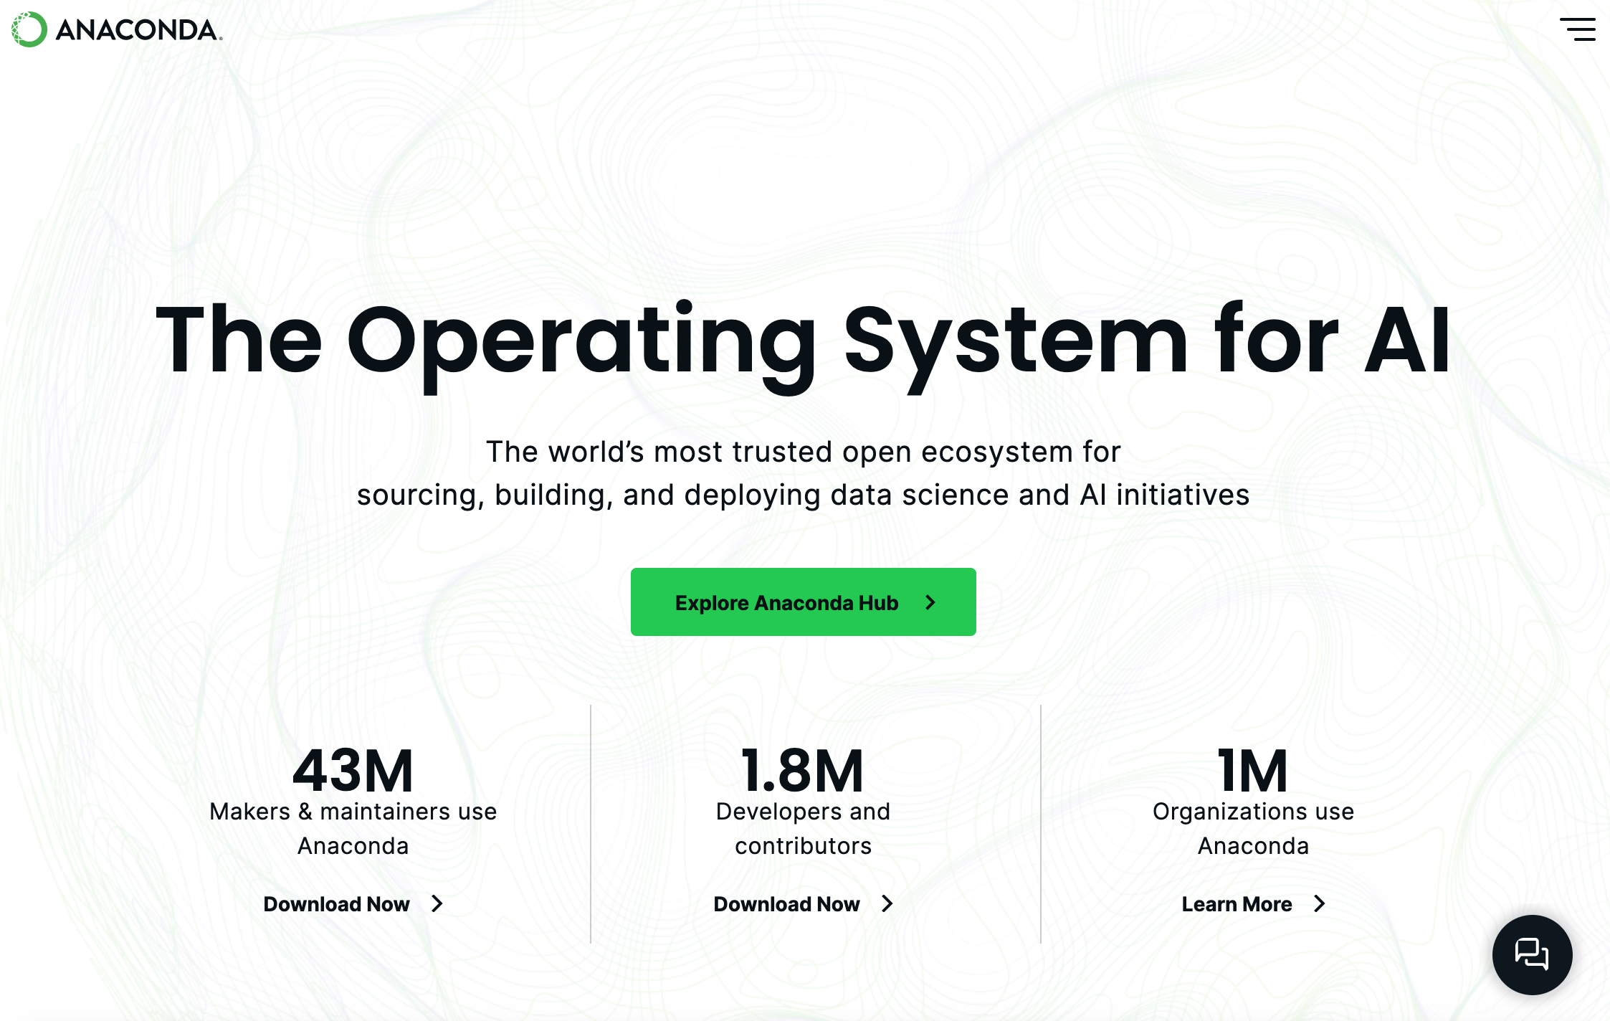
Conda
Conda lets you manage virtual environments in python
Helps keep conflicting dependencies on your machine
Different versions of python
Different versions of supplemental libraries
Environments can be ”exported” to a text file
> conda create –n summer24 python=3.12 > conda activate summer24 > conda install pytorch, ipython, jupyter, ipykernel

Slide 43
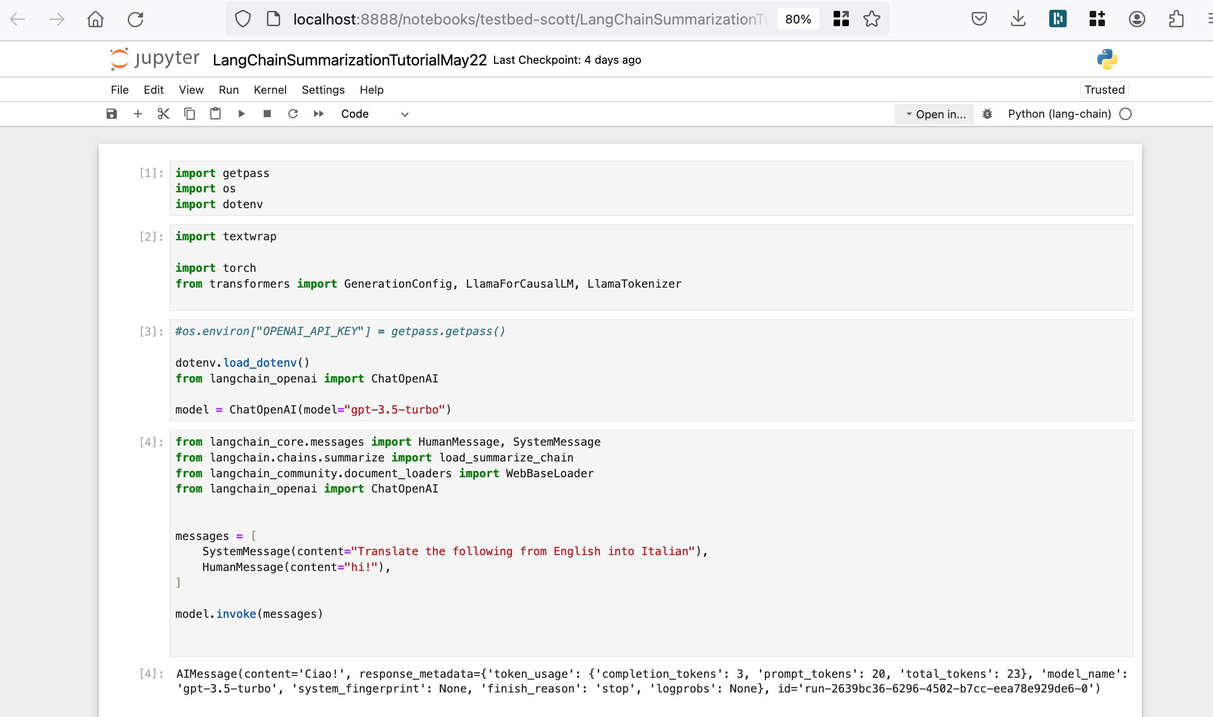
Jupyter
Interactive environment for python
Can be run inside browser or VSCode
Pros:
Easy interaction, plots available inline
Rapid prototyping
Markdown notes can be kept inside
Cons:
Easy to write terrible code
Everything is global
You may not see bugs until you restart the notebook

Slide 44

Google Colab: https://colab.google
Potentially free use of cloud resources
Similar to Jupyter notebook

Slide 45
Git / GitHub
> git init
> git remote add origin <ssh location>
> git add my_notebook.ipynb
> git commit -m “Initial commit”
> git push origin main
Resources:
https://jwiegley.github.io/git-from-the-bottom-up/
https://docs.github.com/en
https://skills.github.com/
Use the command line interface
Be thoughtful about commit messages
Focus on the “why” and high level “what”
First line of commit message should be short
Follow up with additional paragraphs if need be
If you do check in work just to temporarily ”save” it, go back and clean up later
rebase
commit --amend

Slide 46
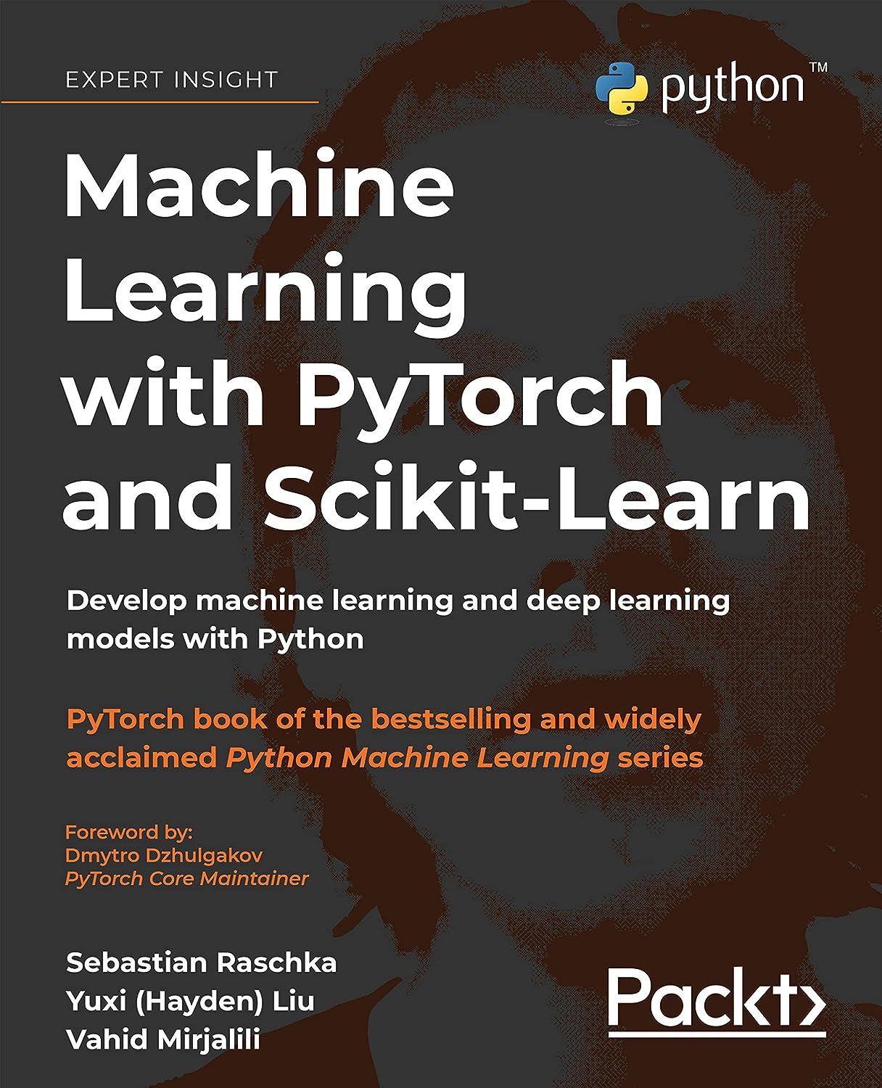
A Book?
Consider this book if you like a physical reference
Beware that these toolkits (especially pytorch) evolve rapidly….
https://pytorch.org/
https://scikit-learn.org

Slide 47
Learning more about Neural Networks
https://www.youtube.com/@AndrejKarpathy
Building micrograd (2h)
https://www.youtube.com/watch?v=VMj-3S1tku0
Makemore series (5 parts, 8h) https://www.youtube.com/watch?v=PaCmpygFfXo
Let’s build GPT from scratch, in code (2h) https://www.youtube.com/watch?v=kCc8FmEb1nY

